Slide 1

MINOR PROJECT-II PRESENTATION
Easy Life Bot
SUBMITTED BY:
SUPERVISED BY
PUSHPAK RUHIL
2019-310-128
BTECH CSE
Dr. SHAH IMRAN ALAM
Assistant Professor,
CSE, SEST, JAMIA HAMDARD
SUBMITTED TO
DEPT. OF COMPUTER SCIENCE ENGINEERING,
SCHOOL OF ENGINEERING SCIENCE AND TECHNOLOGY,JAMIA HAMDARD

Slide 2
Easy Life Chat Bot

Slide 3
INTRODUCTION
With the world shifting towards Artificial Intelligence and Machine learning, we are using many technologies in our day-to-day life to ease our work. It is also important to understand the need of creating a real life environment when, say, talking to an Artificial Intelligent agent.
Easy Life Bot is a chatbot. Chatbots are essentially artificial intelligent software application used to conduct a chat conversation via text or text-to-speech, in lieu of providing direct contact with a live human agent. You send a text to the chatbot and it automatically responds back based on its learning with the data.

Slide 4
PROBLEM STATEMENT
To develop an artificial intelligent chatbot which can be used for chatting, small talks, or performing certain key tasks like searching terms for you, telling you the weather or even converting currencies.
The chatbot should be able to run seamlessly on any device.
The chatbot should understand basic questions and answer accordingly.
Chatbot should be easy for users to understand and use.

Slide 5
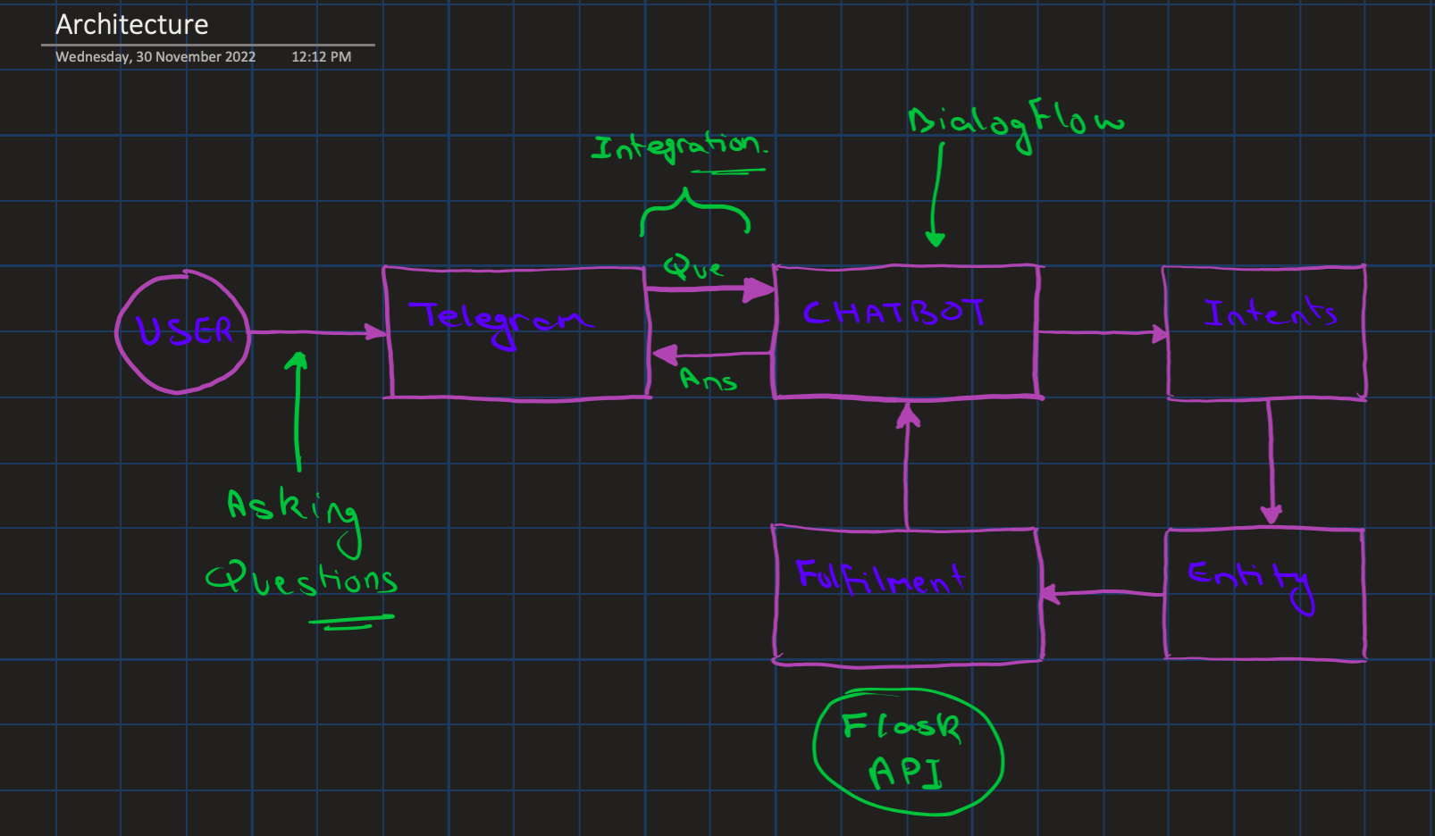
Architecture

Slide 6
TECHNOLOGIES USED
Python
Google’s DIalogFlow
APIs
Ngrok
Telegram

Slide 7
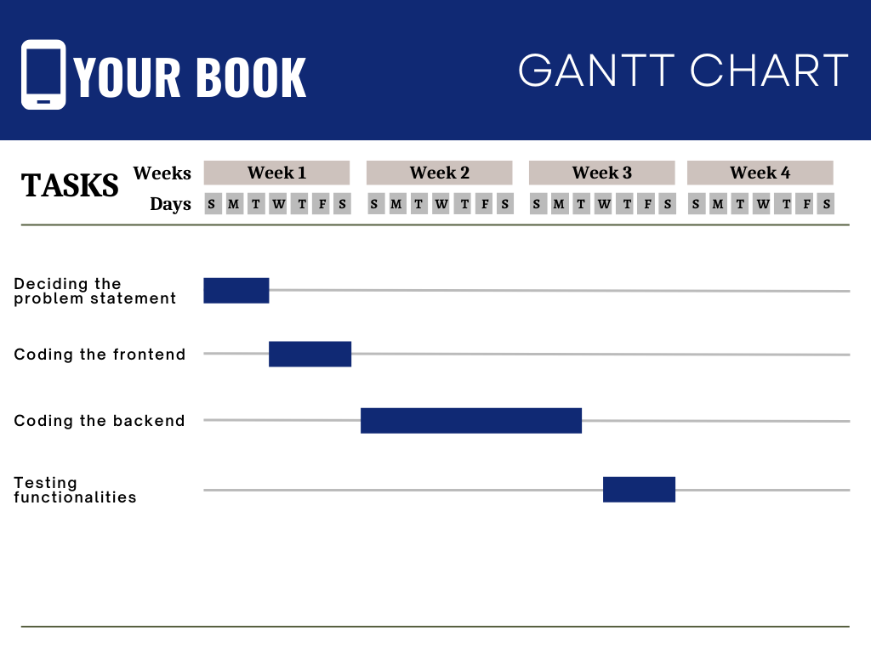

GANTT CHART
Clearing intents
API related work
Designing backend
Integration to telegram

Slide 8
SCREENSHOTS

Slide 9
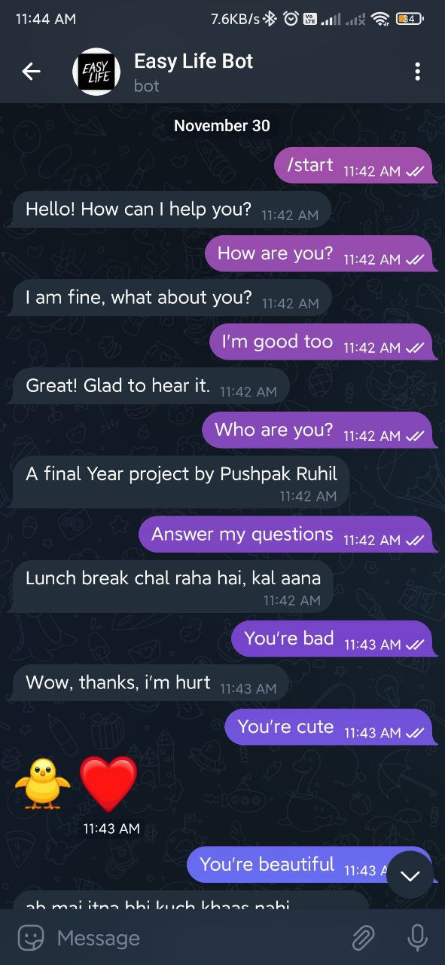

Slide 10
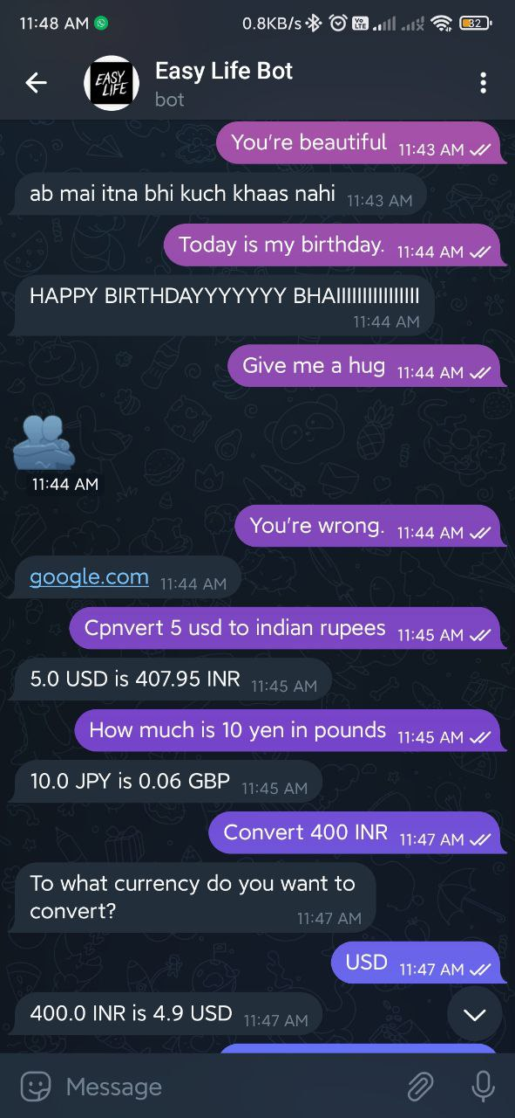

Slide 11
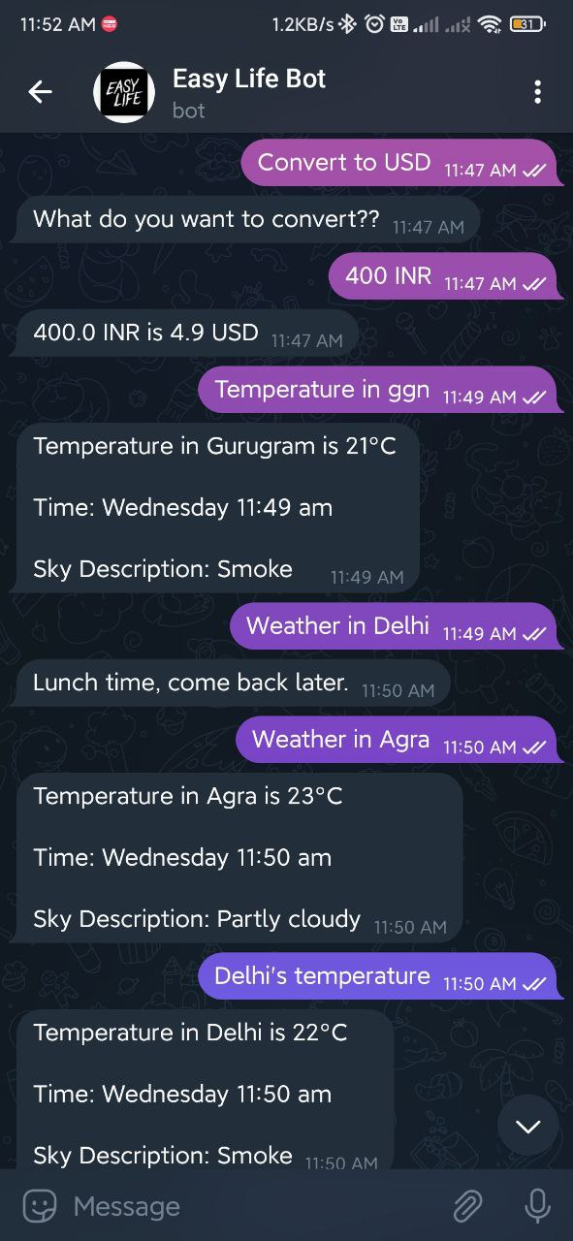

Slide 12
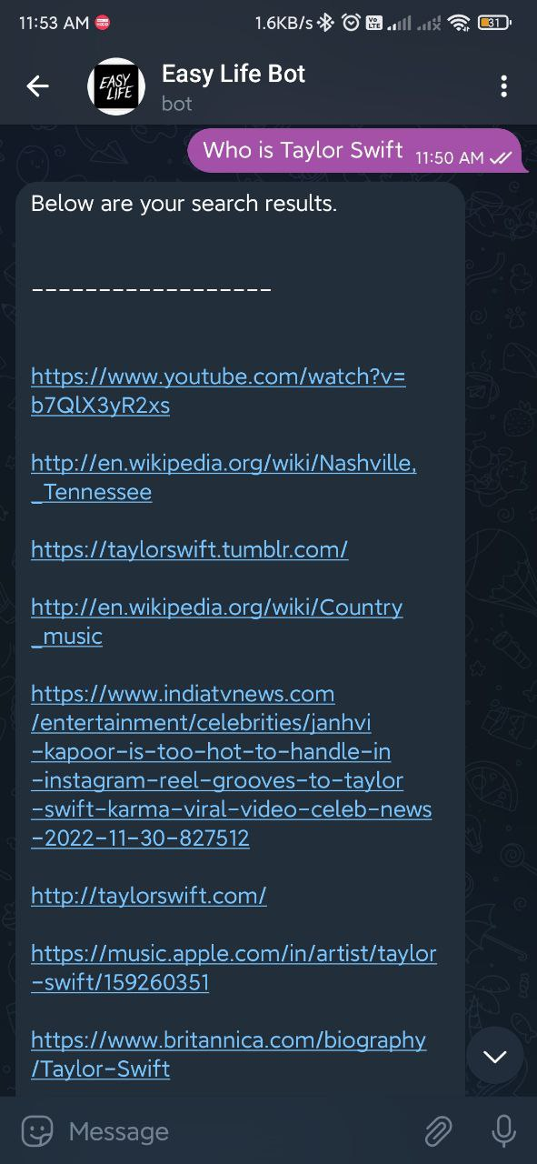

Slide 13
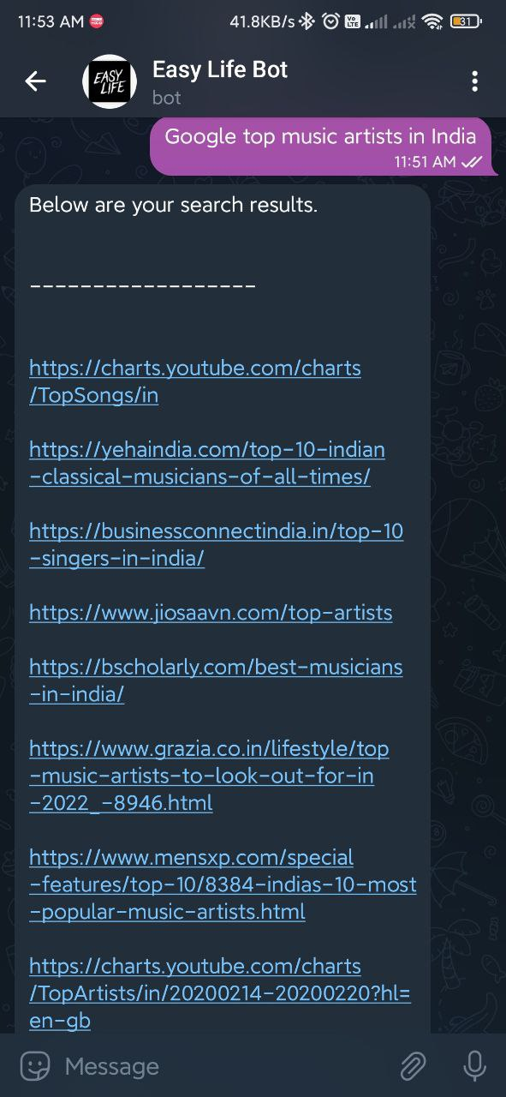

Slide 14
CONCLUSION
As I conclude my project report, I would like to summarize this project. This AI enabled chatbot is an easy to use application to perform daily life actions, all at one single place. This can also be used for small talks which can help lighten your mood. This is just one single use case of a chatbot that I have implemented, but there are various industry level use cases as well. Many companies use such chatbot agents to reduce the manual labor, say for customer service.

Slide 15
THANK YOU!

